Slide 1
Arduino Project
by
03. Kaushiki Ambi
04. Ved Aralkar
06. Aamir Sabir
33. Saanya Jain
37. Mohnish Jham

Slide 2
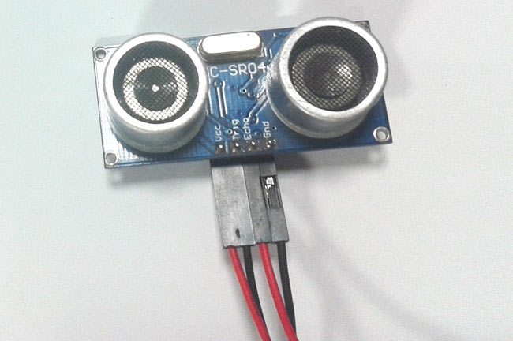
Distance measurement using Arduino.
Ultrasonic sensors are great tools to measure distance without actual contact and used at several places like water level measurement, distance measurement etc. This is an efficient way to measure small distances precisely. In this project we have used an Ultrasonic Sensor to determine the distance of an obstacle from the sensor.

Slide 3
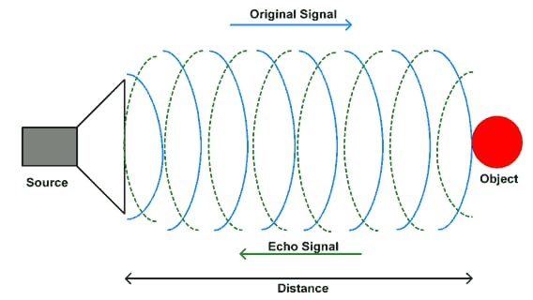
Principles used
Basic principal of ultrasonic distance measurement is based on ECHO. When sound waves are transmitted in environment then waves are return back to origin as ECHO after striking on the obstacle. So we only need to calculate the travelling time of both sounds means outgoing time and returning time to origin after striking on the obstacle. As speed of the sound is known to us, after some calculation we can calculate the distance.

Slide 4
Components used
1. Arduino Uno or Pro Mini
2. Ultrasonic sensor Module
3. 16x2 LCD
4. Scale
5. Bread Board
6. 9 volt battery
7. Connecting wires

Slide 5
Connections
n circuit connections Ultrasonic sensor module’s “trigger” and “echo” pins are directly connected to pin 18(A4) and 19(A5) of arduino. A 16x2 LCD is connected with arduino in 4-bit mode. Control pin RS, RW and En are directly connected to arduino pin 2, GND and 3. And data pin D4-D7 is connected to 4, 5, 6 and 7 of arduino.
First of all we need to trigger the ultrasonic sensor module to transmit signal by using arduino and then wait for receive ECHO. Arduino reads the time between triggering and Received ECHO. We know that speed of sound is around 340m/s. so we can calculate distance by using given formula:
Distance= (travel time/2) * speed of sound
Where speed of sound around 340m per second.
A 16x2 LCD is used for displaying distance.

Slide 6
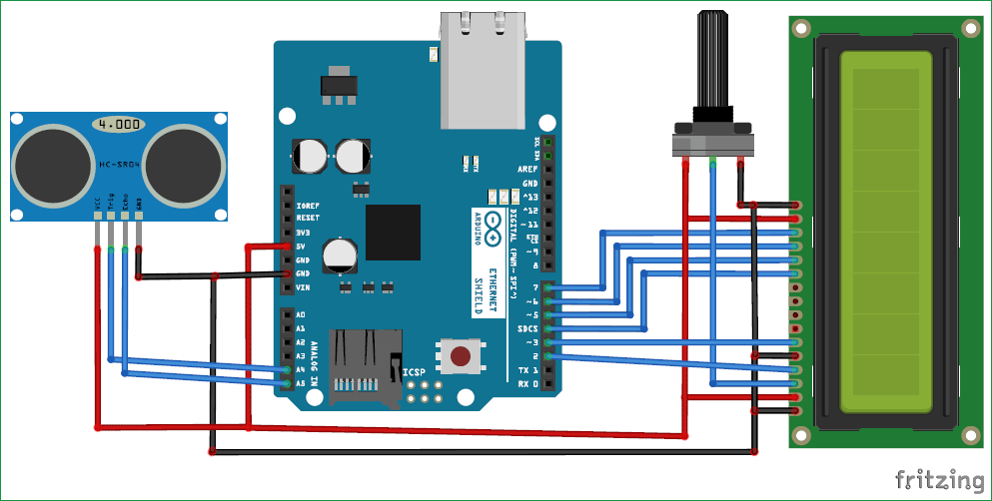
Circuit Diagram

Slide 7
Code
#include <LiquidCrystal.h>
#define trigger 18
#define echo 19
LiquidCrystal lcd(2,3,4,5,6,7)
float time=0,distance=0;
void setup()
{
lcd.begin(16,2);
pinMode(trigger,OUTPUT);
pinMode(echo,INPUT);
lcd.print(" Ultra sonic");
lcd.setCursor(0,1);

Slide 8
Code continued..
lcd.print("Distance Meter");
delay(2000);
lcd.clear();
lcd.print(" Circuit Digest");
delay(2000);
}
void loop()
{
lcd.clear();
digitalWrite(trigger,LOW);
delayMicroseconds(2);

Slide 9
Codes continued..
digitalWrite(trigger,HIGH);
delayMicroseconds(10);
digitalWrite(trigger,LOW);
delayMicroseconds(2);
time=pulseIn(echo,HIGH);
distance=time*340/20000;
lcd.clear();
lcd.print("Distance:");
lcd.print(distance);
lcd.print("cm");

Slide 10
Codes continued..
lcd.setCursor(0,1);
lcd.print("Distance:");
lcd.print(distance/100);
lcd.print("m");
delay(1000);
}

Slide 11
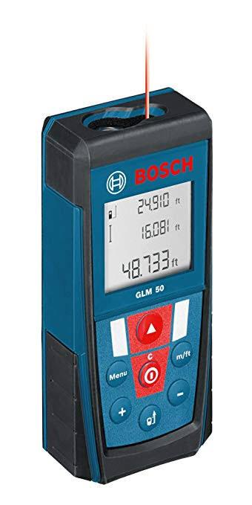
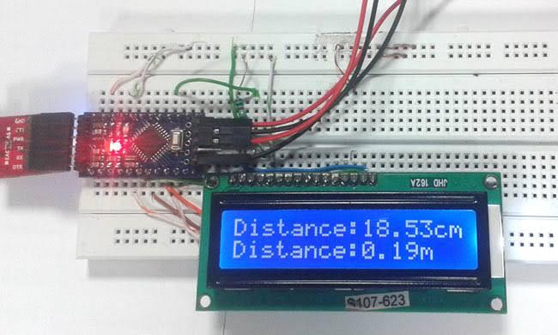
Applications
Ultrasonic sensors can precisely measure the distance to a target object. They
are preferred to traditional sensors because of their ability to detect and
Measure moving objects. They can measure the distance of an object regardless
of its shape, colour or surface texture.

Slide 12
Thank you!!

